Slide 1

From Requirements to Collection

Slide 2
Objectives
Understand Data Requirements
Understand Data Collection
Data Science Methodology

Slide 3
Data Requirements
Let's analyze the following situation: if your goal is to make a spaghetti dinner but you don't have the right ingredients to make the dish, then your success will be compromised.
→ So, if the problem that needs to be resolved is the recipe, so to speak, and data is an ingredient, then the data scientist needs to identify: which ingredients are required, how to source or to collect them, how to understand or work with them, and how to prepare the data to meet the desired outcome.
Building on the understanding of the problem at hand, and then using the analytical approach selected, the Data Scientist is ready to get started.
Data Science Methodology

Slide 4
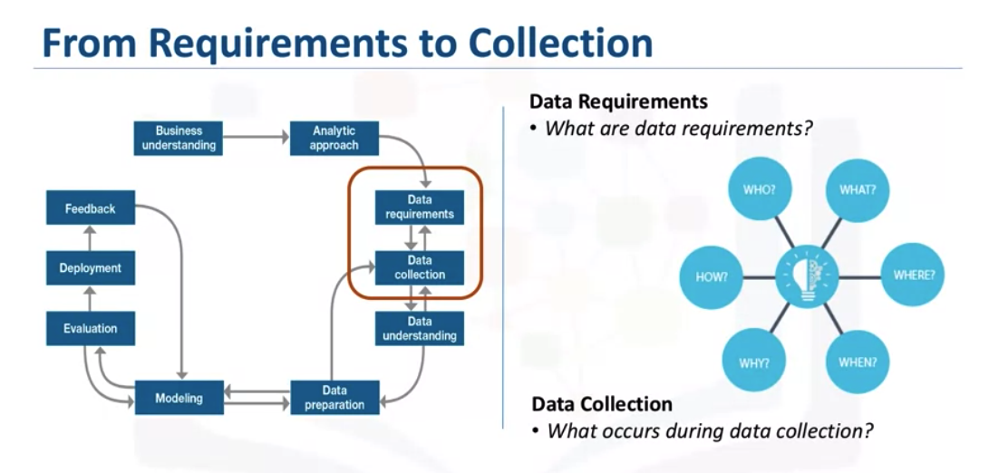
Data Requirements
Data Science Methodology

Slide 5
Data Requirements
Prior to undertaking the data collection and data preparation stages of the methodology, it's vital to define the data requirements for decision-tree classification. This includes identifying the necessary data content, formats and sources for initial data collection.
The question being asked is: What is the best way to allocate the limited healthcare budget to maximize its use in providing quality care? What is data requirements?
  the first task was to define the data requirements for the decision tree classification approach that was selected. This included selecting a suitable patient cohort from the health insurance providers member base
Data Science Methodology

Slide 6
Data Requirements
The complete clinical histories, three criteria were identified for inclusion in the cohort.
  A patient needed to be admitted as in-patient within the provider service area, so they'd have access to the necessary information.
  Second, they focused on patients with a primary diagnosis of congestive heart failure during one full year.
  Third, a patient must have had continuous enrollment for at least six months, prior to the primary admission for congestive heart failure
This modeling technique requires one record per patient, with columns representing the variables in the model. To model the readmission outcome, there needed to be data covering all aspects of the patient's clinical history.
Data Science Methodology

Slide 7
Data Requirements
This content would include admissions, primary, secondary, and tertiary diagnoses, procedures, prescriptions, and other services provided either during hospitalization or throughout patient/doctor visits.
Thus, a particular patient could have thousands of records, representing all their related attributes.
Data Science Methodology

Slide 8
Data Collection
After the initial data collection is performed, an assessment by the data scientist takes place to determine whether or not they have what they need.
As is the case when shopping for ingredients to make a meal, some ingredients might be out of season and more difficult to obtain or cost more than initially thought.
In this phase the data requirements are revised and decisions are made as to whether or not the collection requires more or less data.
Once the data ingredients are collected, then in the data collection stage, the data scientist will have a good understanding of what they will be working with.
Data Science Methodology

Slide 9
Data Collection
Techniques such as descriptive statistics and visualization can be applied to the data set, to assess the content, quality, and initial insights about the data.
Gaps in data will be identified and plans to either fill or make substitutions will have to be made.
The data collection stage is undertaken as a follow-up to the data requirements stage.
Collecting data requires that you know the source or, know where to find the data elements that are needed.
Data Science Methodology

Slide 10
Data Collection
The question being asked is: What is the best way to allocate the limited healthcare budget to maximize its use in providing quality care? → What is data collection?
In the context of our case study, these can include: demographic, clinical and coverage information of patients, provider information, claims records, as well as pharmaceutical and other information related to all the diagnoses of the congestive heart failure patients.
For this case study, certain drug information was also needed, but that data source was not yet integrated with the rest of the data sources.→ It is alright to defer decisions about unavailable data, and attempt to acquire it at a later stage.
Data Science Methodology

Slide 11
Data Collection
For example, this can even be done after getting some intermediate results from the predictive modeling.
If those results suggest that the drug information might be important in obtaining a good model, then the time to try to get it would be invested.
As it turned out though, they were able to build a reasonably good model without this drug information.
Stakeholders, they sit together to extract data from various sources, and then merge it. This allows for removing redundant data, making it available for the next stage of the methodology
Data Science Methodology

Slide 12
Data Collection
At this stage, if necessary, data scientists and analytics team members can discuss various ways to better manage their data, including automating certain processes in the database, so that data collection is easier and faster.
Data Science Methodology

Slide 13
Summary
Understand Data Requirements
Understand Data Collection
Data Science Methodology

Slide 14
Q & A
Data Science Methodology

